Slide 1
Case Adjuster portal demo
Copyright ©2022 Akeso Occupational Health

Slide 2
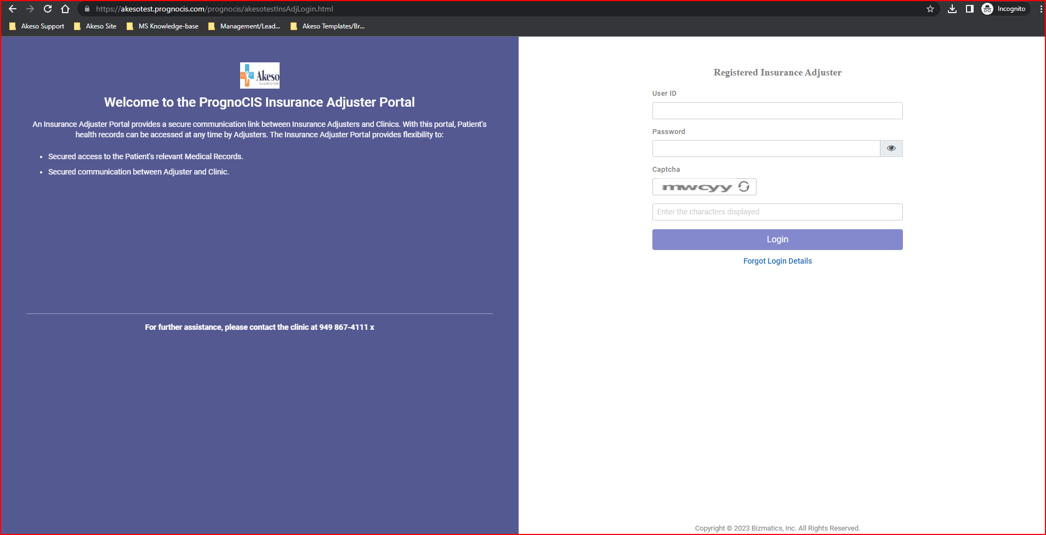
Logon Page
Secure user access managed
internally

Slide 3
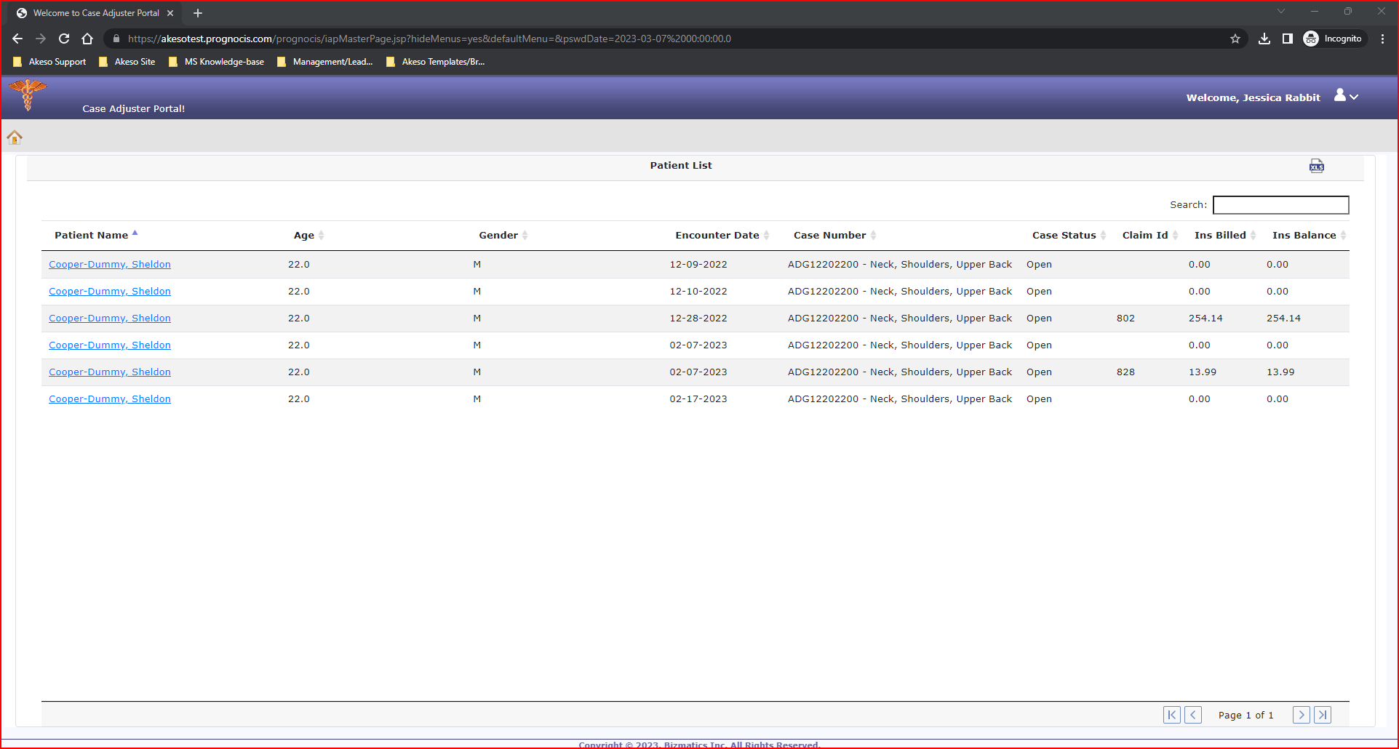
Home Page >> Patient Info/Case Information
Relevant clinical details available following patient visit

Slide 4
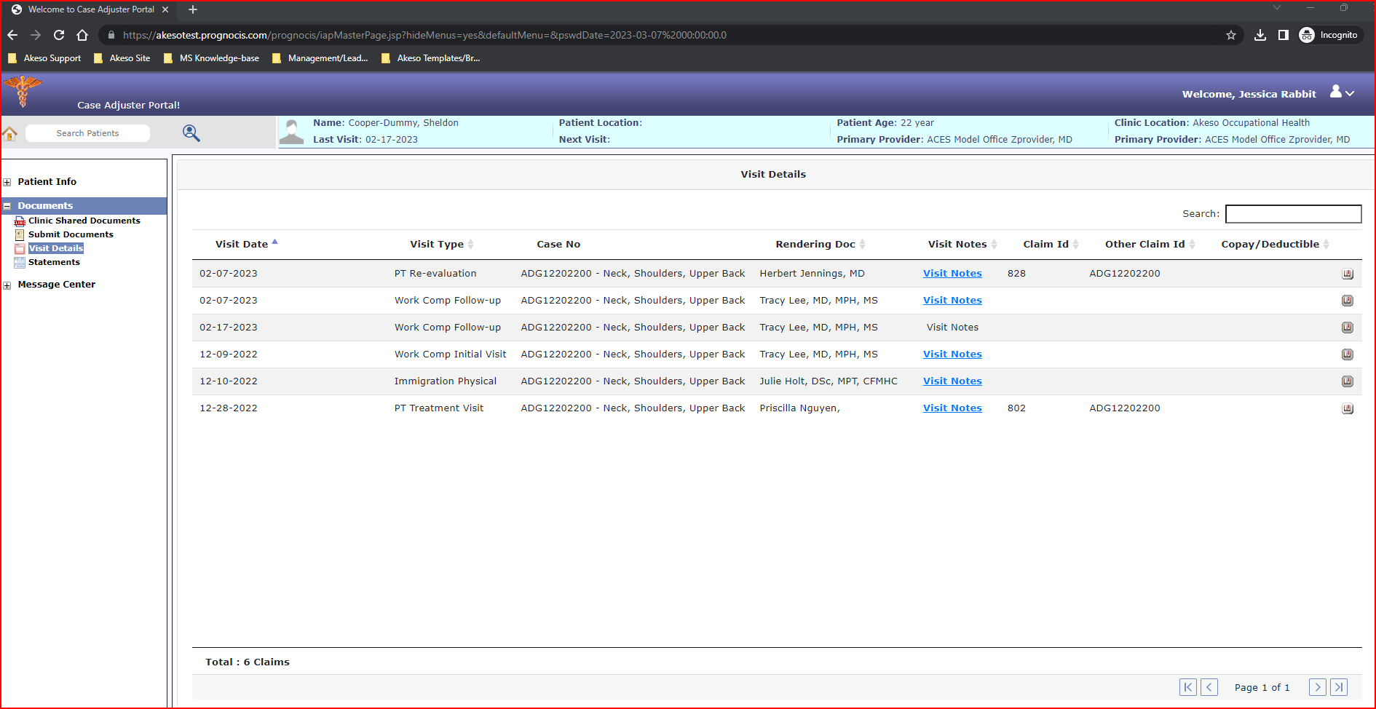
Patient Info >> Case Information
Access specific Claim Information

Slide 5
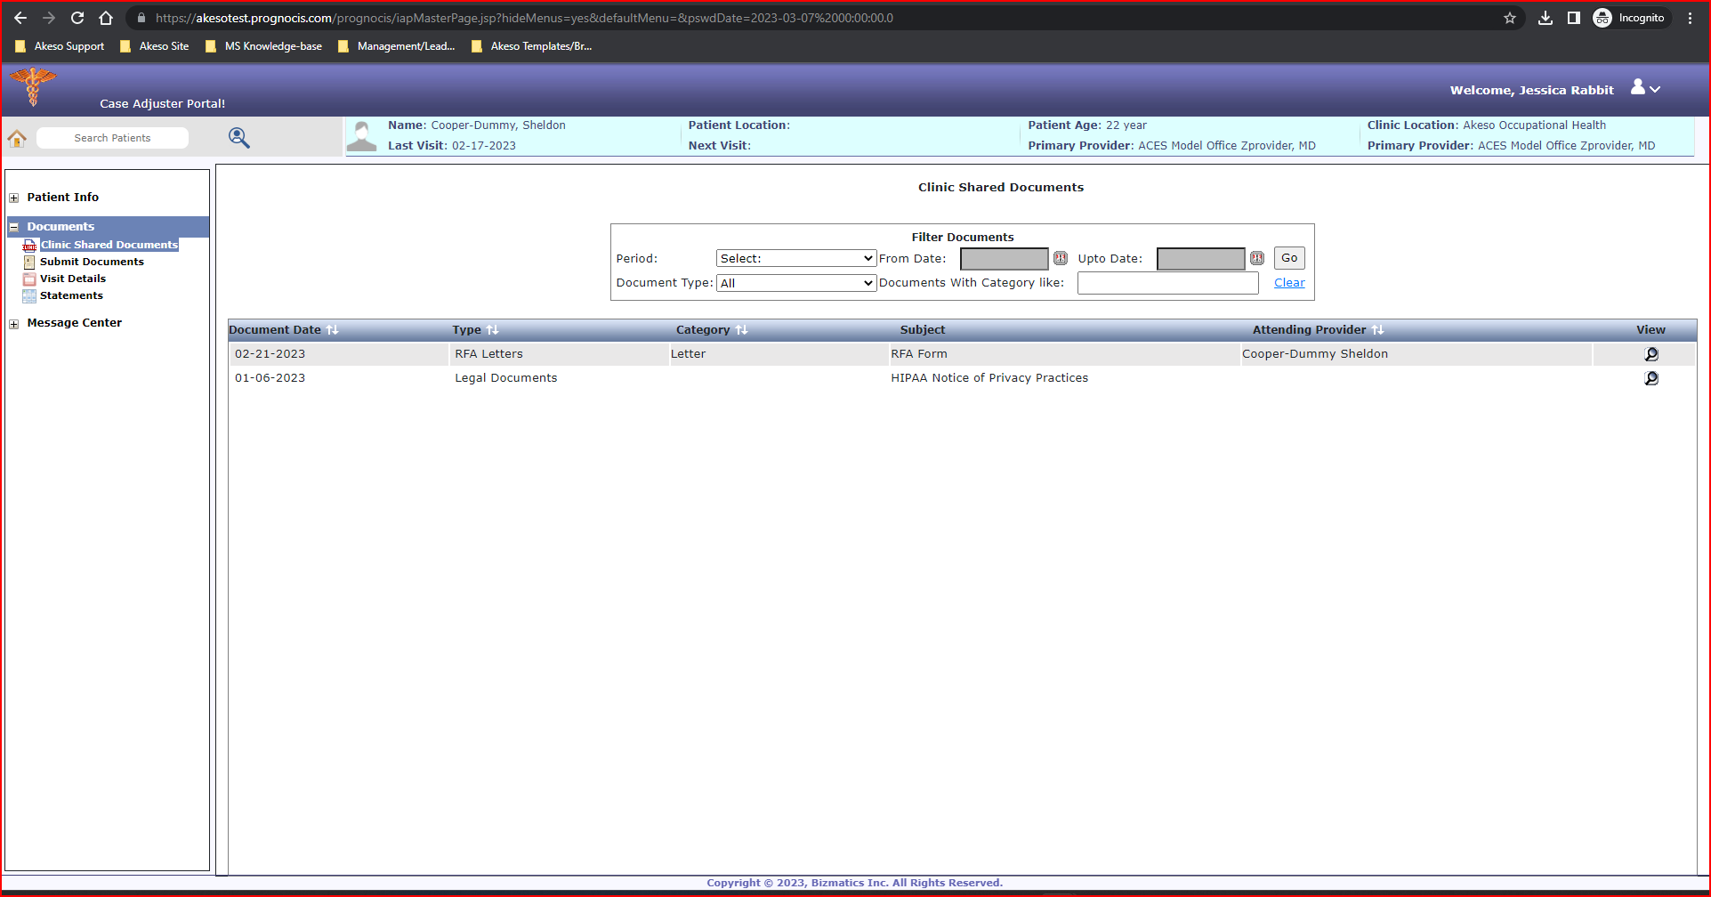
Patient Info >> Documents >> Clinic Shared Documents
Search for Patient Documents

Slide 6
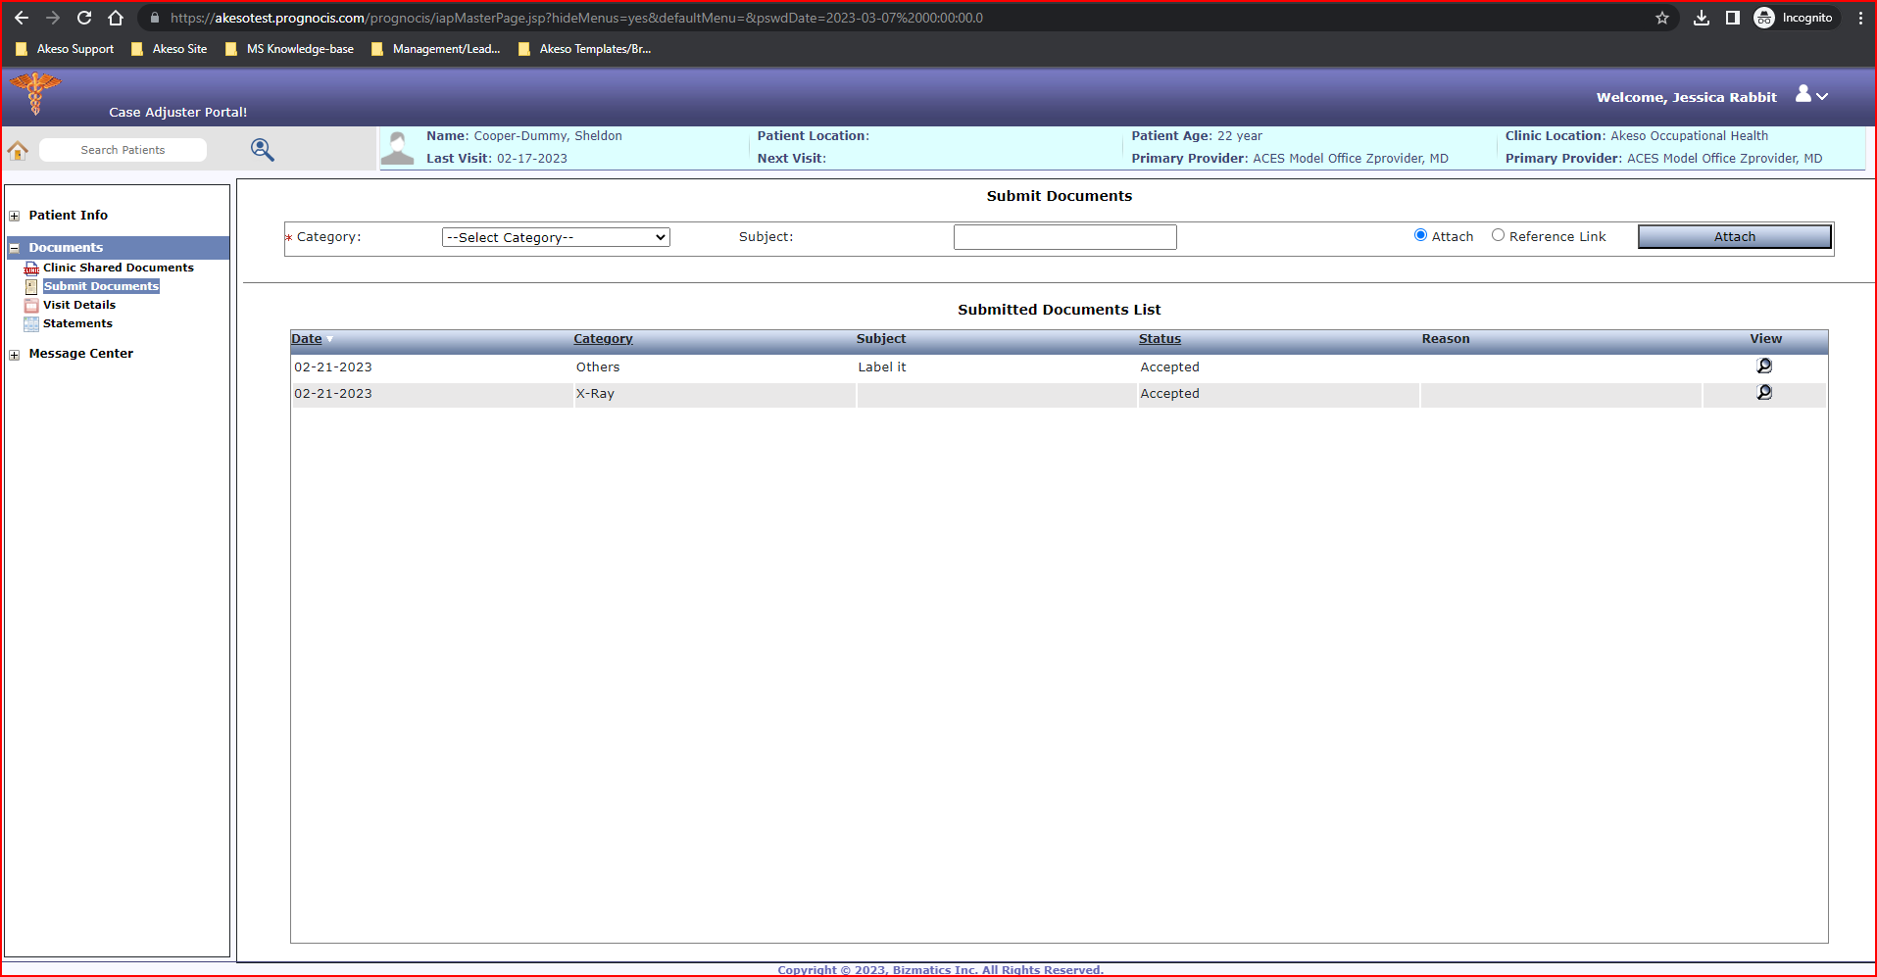
Patient Info >> Documents >> Share Documents with Akeso Team
Ability to share documents with Akeso Occupational Heath Team

Slide 7
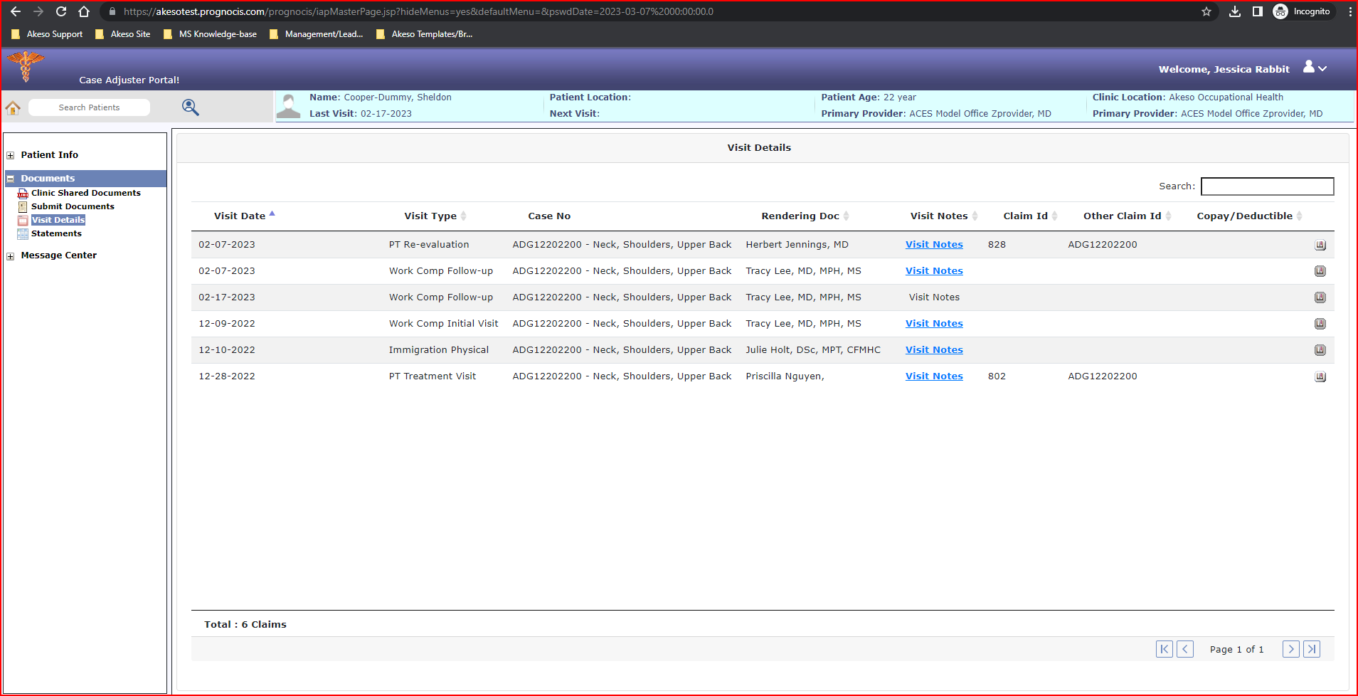
Patient Info >> View Visit Details
View Visit Details

Slide 8
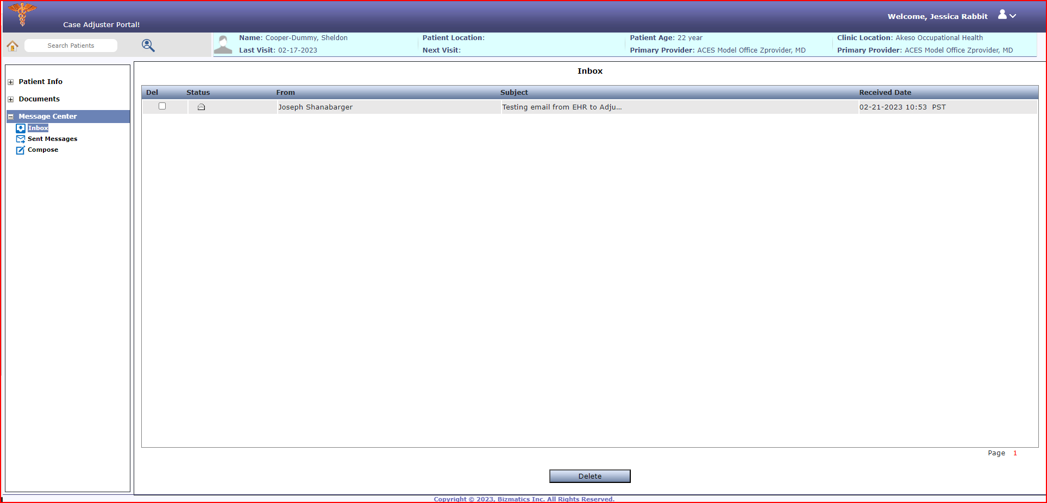
Patient Info >> Message Center
Ability to Communicate with Akeso Occupational Health Team

Slide 9
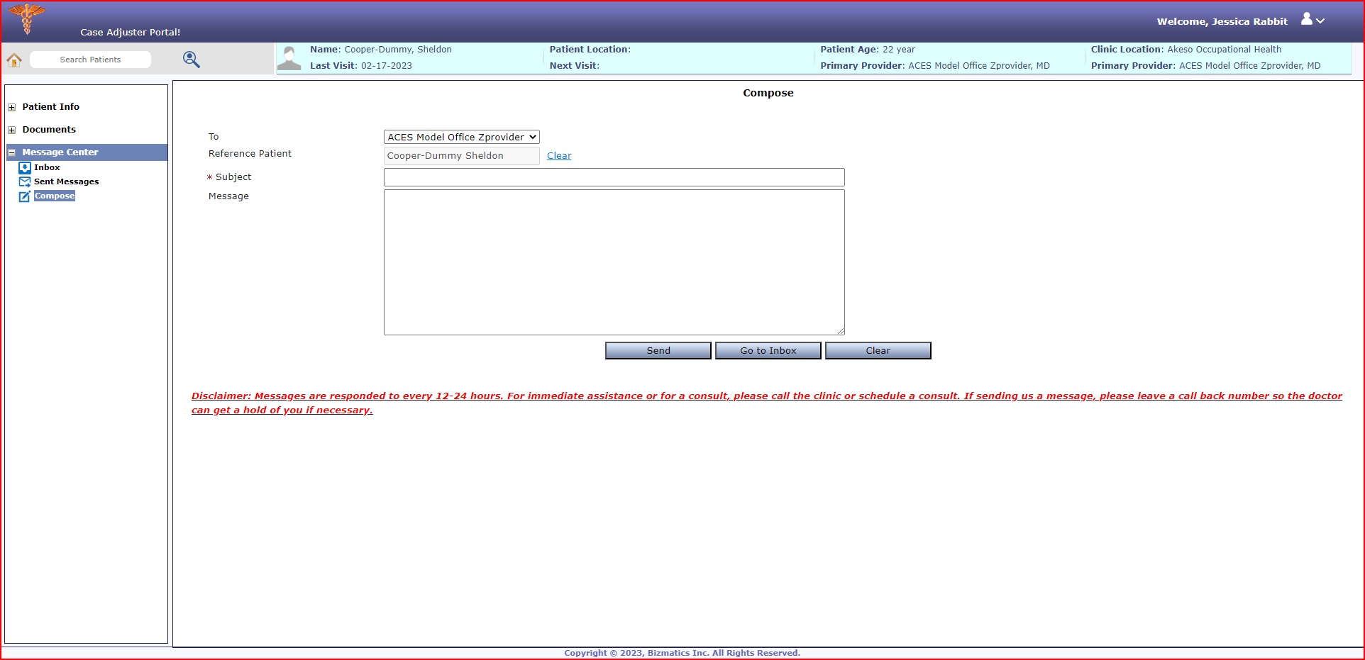
Patient Info >> Message Center >> Compose a Message
Messaging the Akeso Team

Slide 10
Patient Chart >> View Visit Details
Thank you for participating
Questions?

